Slide 1
Knowledge Engineering
Hugo Collins
40446925

Slide 2
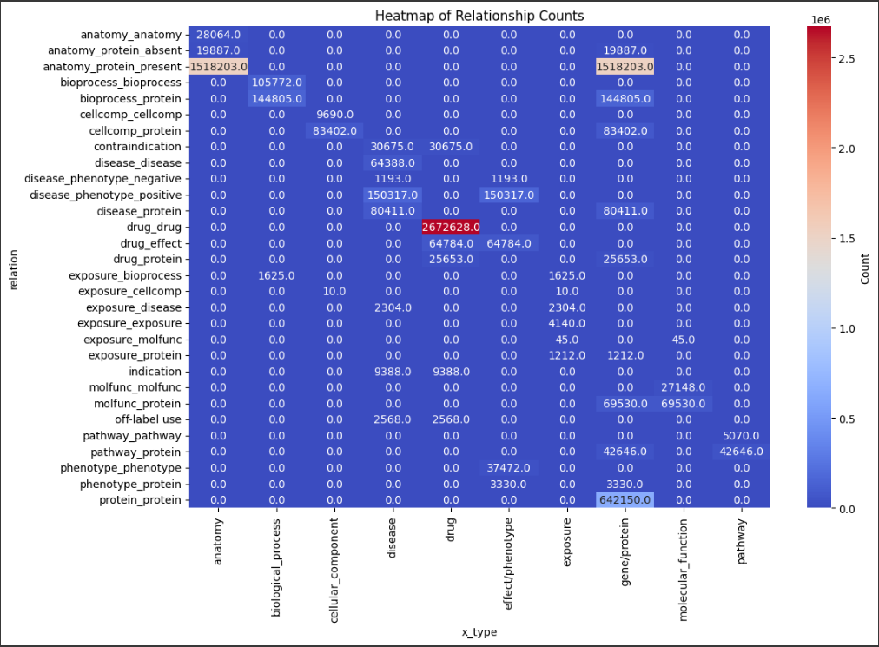
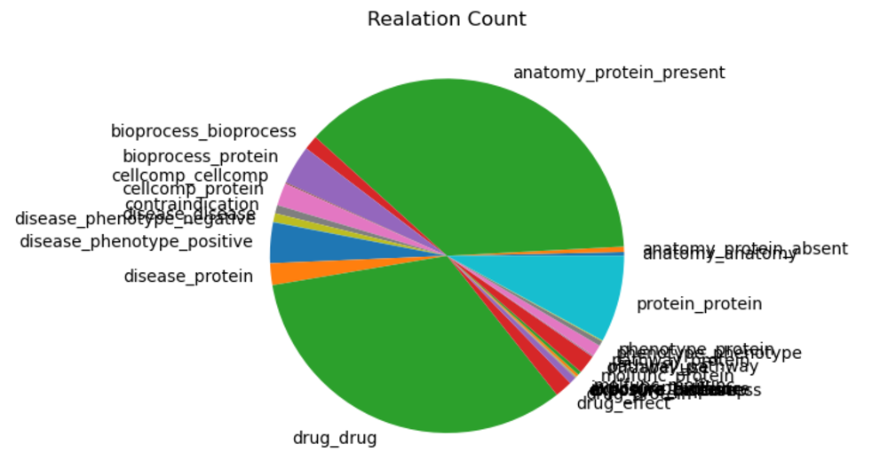
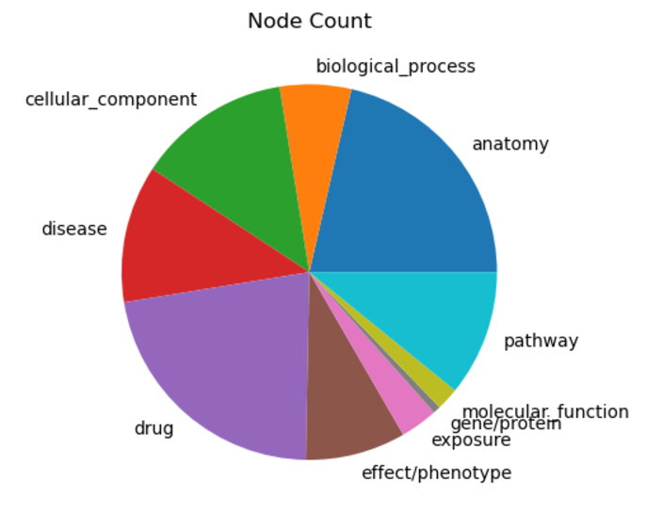
Section 1: Data Exploration
Pie chart of Node Counts
Pie chart of Relation Counts
Heatmap of relation between node and relation types
Discrepancies between published and mine:
In the published paper they have same number of nodes but only 4,050,249 relations
I have exactly double
There are two alternative directed edges for each one
Key stats:
30 unique relation types
anatomy_protein_present most common with over 3 million counts
10 unique node types
Biological_process the most common node with 28,642
Counts when using x_type were same as in Chandak 2023

Slide 3
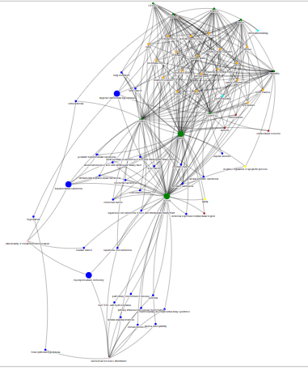
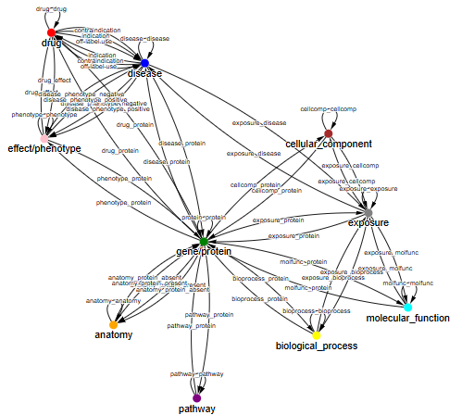
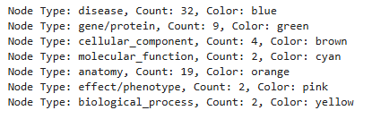
Section 2: Exploring the Knowledge Graph
Ontology Plot using Gravis
Shortest Path represented through the bigger nodes.
Genes were the key link nodes here
Shortest path through MPO, hepatocellular carcinoma (liver cancer), PTEN
Subgraph Consists of
Issue: Naming conflicts arose in the graph when several nodes shared names with entities, causing type errors due to inconsistent handling as objects or entities.
Solution: Resolved conflicts by using x_index as the unique node identifier and storing original names as attributes, ensuring error-free graph population.
Subgraph Plot between diseases – myeloperoxidase deficiency and atypical endometrial hyperplasia with 70 nodes and 307 non directed edges

Slide 4


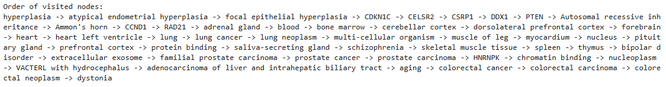
Section 3: Deriving a Knowledge Base and Inferring New Relations
Knowledge Base 1
Knowledge Base 2
Inferred Relationship 1: hyperplasia (disease) -> dystonia (disease) through BFS and Forward Chaining
Inferred Relationship 2: aging (biological_process) -> prostate cancer (disease)
- Connected through MPO gene, surprising this relation wasn’t explicitly made
Inferred Relationship 3: heart (anatomy) -> Abnormality of metabolism/homeostasis (effect/phenotype)
Connected through a gene (CCND1) which is a common trend and also through liver cancer which is an interesting discovery.

Slide 5
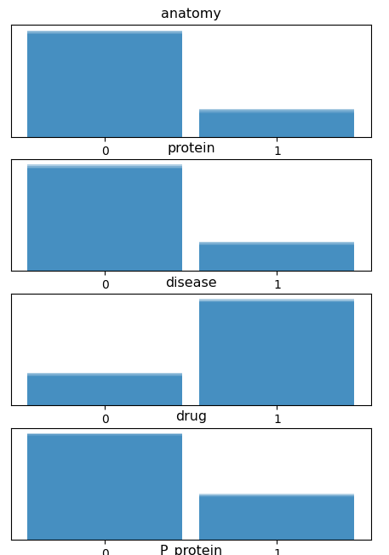
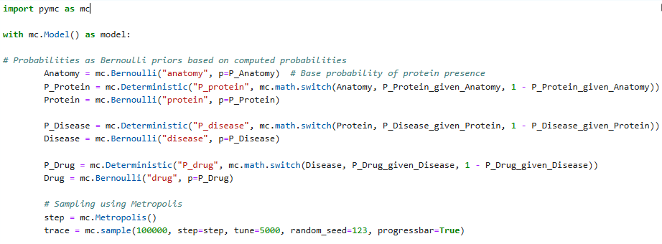
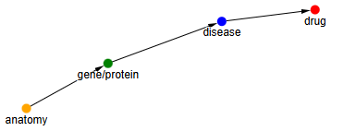
Section 4: A Bayesian View of the Data
Plot of decomposition
Plot of Trace
P(Protein, Drug, Disease, Anatomy) = P(Anatomy) P(Protein|Anatomy) P(Disease|Protein) P(Drug|Disease)

Slide 6
Conclusion
Key Takeaways:
Benefits of Knowledge graphs ability to store information and links
There are a few discrepancies in the way that the paper count their number of edges which is strange
Proteins dominate the graph as the key link despite bio_processes having the highest node count
There are some very interesting new relationships that can be inferred from the graph
Bayesian model was quite challenging and deciding an order was difficult given the bidirectional nature of the data
Had a lot of challenges in the process but was very rewarding to work through them

